Slide 1
Comments and alternative to the SMUD proposed rates for 2020 and 2021
By Mark G.
Presented at the SMUD rate hearing on
June 4, 2019

Slide 2
Summary
SMUD’s proposed rates for 2020 and 2021 violate Article XIII C of the California Constitution on Voter Approval for Local Tax Levies because without voter approval SMUD is:
1. extending and increasing current TOD rates, which exceed the reasonable costs to SMUD of providing electric service by 9.2% as a result of the previous rate process; and
2. extending and increasing the System Infrastructure Fixed Charge (SIFC)

Slide 3
Alternative
SMUD should:
Remove the 9.2% “scalar” that SMUD added when it created the TOD rates in June, 2017 and then raise rates by 4.75% and 4.50% for 2020 and 2021.
2. Eliminate the System Infrastructure Fixed Charge.

Slide 4
The California Constitution, Article XIII C, section 2(d) says:
(d) No local government may impose, extend, or increase any special tax unless and until that tax is submitted to the electorate and approved by a two-thirds vote.
SMUD is not planning to submit the proposed rates to the electorate for a vote. The only vote will be by the SMUD Board of Directors.

Slide 5
A tax is extended when an agency lengthens the time period during which it applies. Gov. Code, § 53750, subd. (e). A tax is increased when an agency revises its methodology for calculating a tax and the revision results in increased taxes being levied on any person or parcel. § 53750, subd. (h)(1).
Webb v. City of Riverside, 23 Cal. App. 5th 244, 258.

Slide 6
A tax is “any levy, charge, or exaction of any kind imposed by a local government, except” for 7 exceptions. The most relevant of those exceptions is Article XIII C, Section 1 (e) (2):
“(2) A charge imposed for a specific government service or product provided directly to the payor that is not provided to those not charged, and which does not exceed the reasonable costs to the local government of providing the service or product.”

Slide 7
According to Ordinance 15-1 SMUD should answer, and should have already answered, all legal questions it received about the Report and the proposed rates for 2020 and 2021.
“(h) Members of the public may submit questions related to the Report in writing at any time after release of the Report up until five (5) business days prior to the public hearing. To the extent practicable, SMUD staff shall respond to such questions in writing within five (5) business days of receipt.”
There is no distinction made between legal questions or any other type.
Unfortunately SMUD (per General Counsel Laura Lewis) has refused to answer any legal questions about the proposed rates and Proposition 26.

Slide 8
The first question is, “Do the current TOD rates exceed SMUD’s reasonable costs of providing electricity service?”
SMUD’s Rate (RT02) Design Study, mentioned in Appendix I of the 2017 CEO and GM Report, answers that question. The Rate Design Study is proof that current residential TOD rates violate Article XIII C of the California Constitution.

Slide 9
SMUD’s current rates were set on June 15, 2017 in Resolution 17-06-09. SMUD published a CEO and GM Report and Recommendation on Rates and Services (the “2017 Report”).
That Report contained, as Appendix I, a letter dated December 6, 2016 from NERA Economic Consulting addressed to SMUD’s Resource Planning and Pricing Department (RP&P). The subject of the letter was NERA’s independent review of SMUD’s 2016 Marginal Cost of Service (MCS) Study and its proposed residential Time of Use (TOU) rates for the period 2017 – 2019. That letter was pages 109 – 112 of the Report.

Slide 10
NERA wrote that it had reviewed SMUD documents including the 2018 Residential Time-of-Use Rate (RT02) Design Study (“Rate (RT02) Design Study”). That study quantified the marginal cost components of SMUD’s then proposed residential Time of Day (TOD) rates.
Marginal cost components were: Generation, Capacity, RPS, Transmission, Subtransmission, Distribution, Distribution Facilities, Meter and Services. (page 3)

Slide 11
The problem is that after carefully accounting for each Marginal Cost Component SMUD unconstitutionally added a “scalar” of 9.2% to set rate revenues equal to budget revenues.
In other words SMUD had a target for how much money it wanted to take in via residential TOD rates and to reach that target it added 9.2% to its marginal cost.

Slide 12
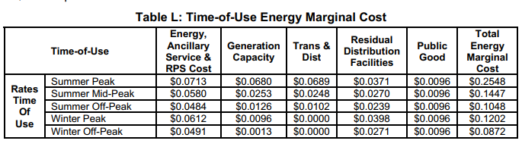
Compare Table L to Table M, both on page 14 in the Rate (RT02) Design Study. Table L:

Slide 13
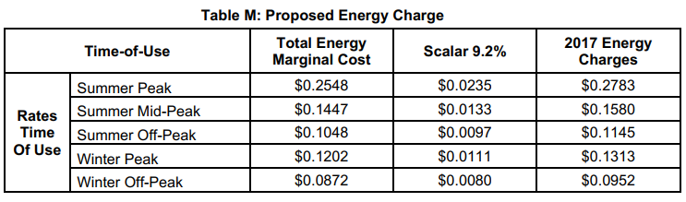
Table M:

Slide 14
SMUD’s explanation of this 9.2% “scalar” is:
“The proposed time-of-use energy rate is completed by setting proposed rate revenues equal to rate revenues for the budget year. The reconciliation of marginal costs to rate revenues is accomplished through increasing final marginal cost energy charges by a scalar of 9.2%.”

Slide 15
Rates must be based on SMUD’s reasonable costs, not on its budget wishes, according to the California Court of Appeal.
“However, if a local government body chooses to impose tiered rates unilaterally without a vote, those tiers must be based on cost of service for the incremental level of usage, not pre-determined budgets.”
(Capistrano case, Order modifying opinion; no change in judgment, dated May 19, 2015.)

Slide 16
CAPISTRANO TAXPAYERS ASSOCIATION, INC., v. CITY OF SAN JUAN CAPISTRANO, G048969, COURT OF APPEAL OF THE STATE OF CALIFORNIA, FOURTH APPELLATE DISTRICT, DIVISION THREE, (Super. Ct. No. 30-2012-00594579)

Slide 17
Current rates are, according to SMUD’s RT02 Rate Design Study, 9.2% higher than SMUD’s marginal cost of providing electricity service.
SMUD’s “setting proposed rate revenues equal to rate revenues for the budget year” is a “pre-determined budget”.
The 9.2% scalar in the current TOD rates is a tax.
The current TOD rates are taxes because of the scalar.

Slide 18
There is no point doing a Rate Design Study if you add to your marginal cost a 9.2% “scalar” in order to “set[] proposed rate revenues equal to rate revenues for the budget year”.
That defeats the purpose of the Rate Design Study.

Slide 19
The second question is, “Do fixed charges violate Article XIII C of the California Constitution?”

Slide 20
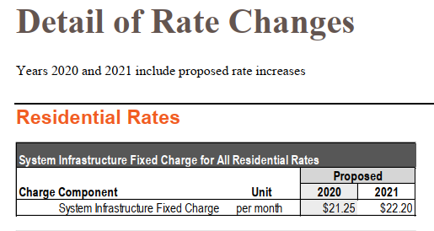
The proposed rates also violate the California Constitution in that SMUD is extending and increasing the System Infrastructure Fixed Charge (SIFC). Page 89 of the CEO and GM Report:

Slide 21
California Constitution, Article XIII C, Section 1:
“The local government bears the burden of proving by a preponderance of the evidence that a levy, charge, or other exaction is not a tax, that the amount is no more than necessary to cover the reasonable costs of the governmental activity, and that the manner in which those costs are allocated to a payor bear a fair or reasonable relationship to the payor’s burdens on, or benefits received from, the governmental activity.”
Emphasis added.

Slide 22
Consider two hypothetical SMUD customers: a single man and a married man with 5 children. The single man’s “burdens on, or benefits received from” SMUD’s electric service are much less than the married man’s. Yet they both pay the same System Infrastructure Fixed Charge.
The SIFC is unfair to the single man and unconstitutional.

Slide 23
Alternative
SMUD should:
Remove the 9.2% “scalar” that SMUD added when it created the TOD rates in June, 2017 and then raise rates by 4.75% and 4.50% for 2020 and 2021.
2. Eliminate the System Infrastructure Fixed Charge.

Slide 24
By adopting my alternative rate proposal SMUD’s rates for 2020 and 2021 will not be special taxes because they will satisfy exemption (e ) (2). They will be truly based on SMUD’s marginal cost as carefully accounted for in the Rate (RT02 ) Design Study. Also, by eliminating the SIFC the manner in which the new rates are allocated to a payor will bear a fair or reasonable relationship to the payor’s burdens on, or benefits received from, the governmental activity.

